Slide 1
Lecture 11: Sequence-to-sequence architectures

Slide 2

Learning settings
slide credit: A. Karpathy
One-to-one: image to class label
One-to-many: text generation/image captioning
Many-to-one: sentiment analysis
Many-to-many 1: machine translation
Many-to-many 2: online classification (e.g. POS tagging)

Slide 3
Bi-directional RNN
[A Graves, PhD thesis]

Slide 4
Uni-directional vs bi-directional
Bi-directional is not applicable when “future” is unavailable
When future is available bi-directional is almost always better
E.g. NLP (batch mode), bioinformatics

Slide 5
Learning settings
slide credit: A. Karpathy
aka “seq2seq”

Slide 6
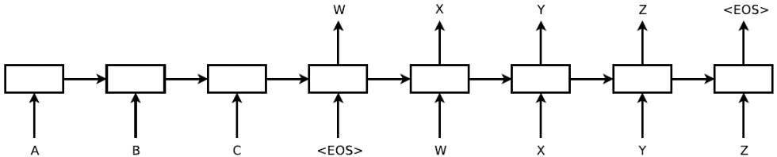
Sequence-to-sequence machine translation
Important notes:
Fixed lexicon (160,000 English, 80,000 French) + ‘UNK’ word
Deep (four layers, 1000 cells in each)
Reversing input sequence helps a lot
Using two different LSTMs
Decoding proceeds by beam search
[Sutskever et al. NIPS14]

Slide 7
Sequence-to-sequence machine translation
[Sutskever et al. NIPS14]
Decoding proceeds by beam search:
At the first step generate top-K words
At each step, expand each of the K in top-L ways (gives KL results)
Pick the best K out of KL results
NB: needs some mechanism to compare sequences of different lengths

Slide 8
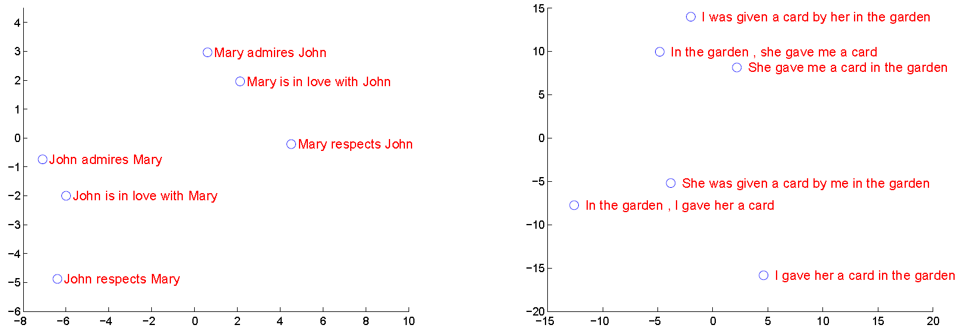
Sequence-to-sequence machine translation
Learned embeddings:
PCA 1000-> 2
[Sutskever et al. NIPS14]

Slide 9
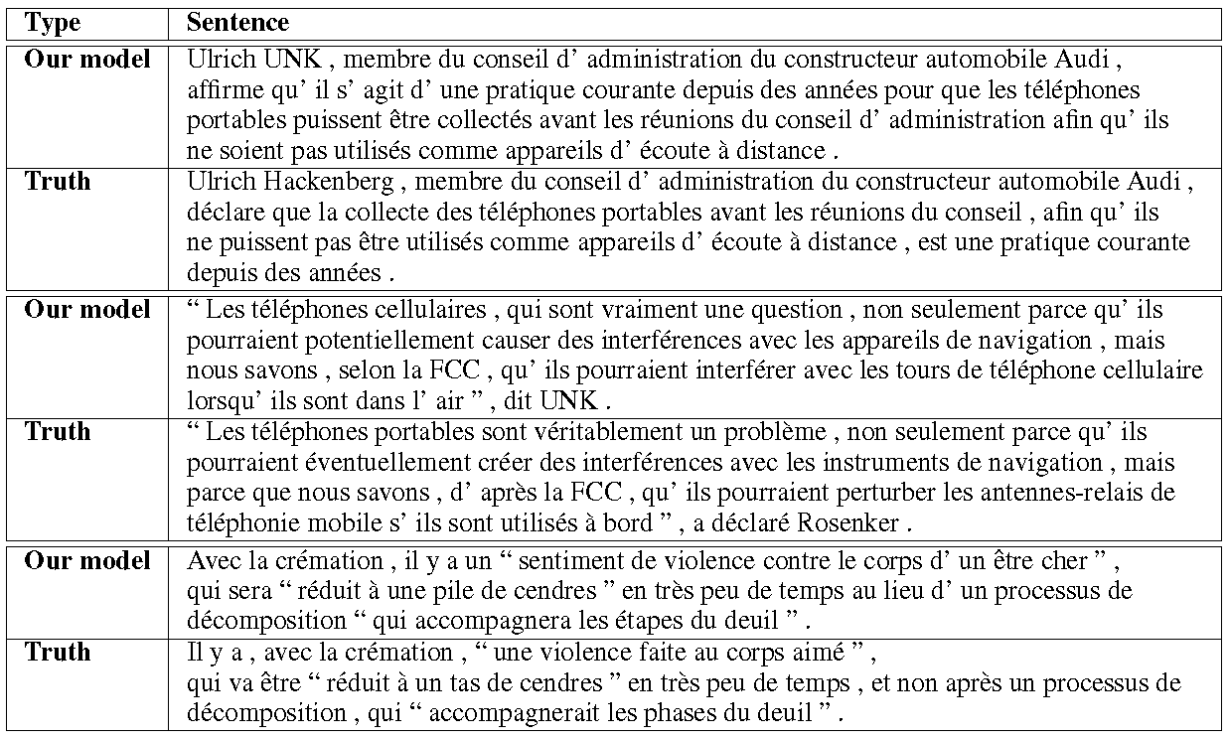
Sequence-to-sequence machine translation
[Sutskever et al. NIPS14]

Slide 10

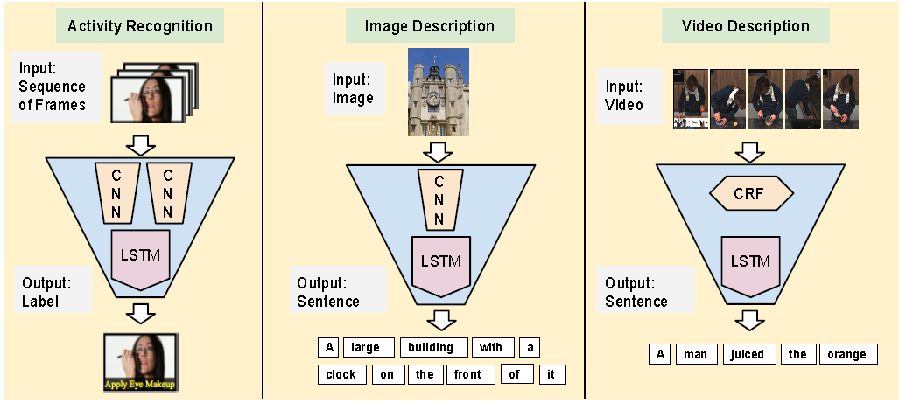
Image/video captioning
[Donahue et al. 2015]

Slide 11
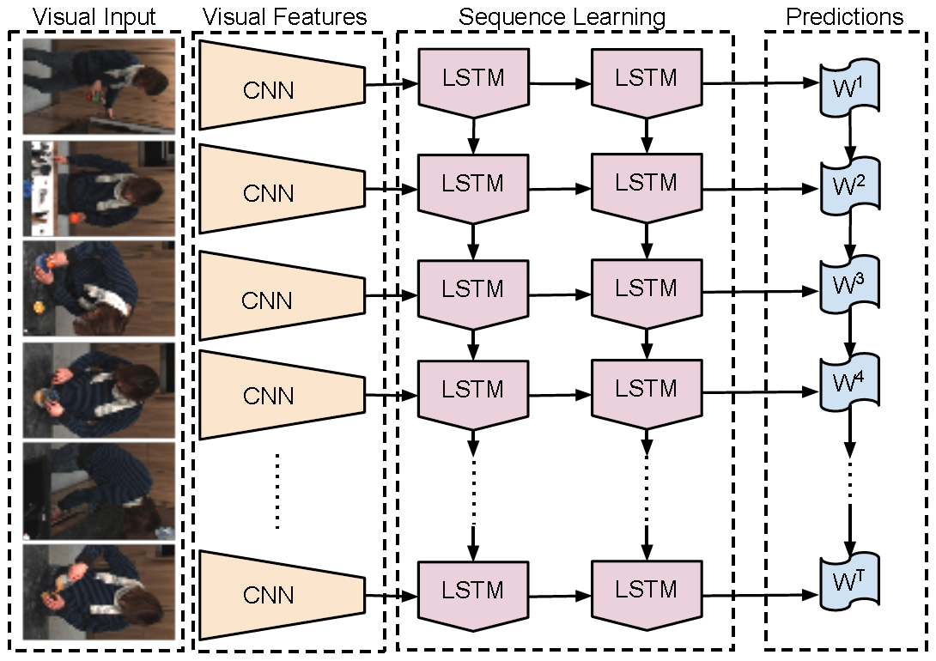
Image/video captioning
[Donahue et al. 2015]*

Slide 12
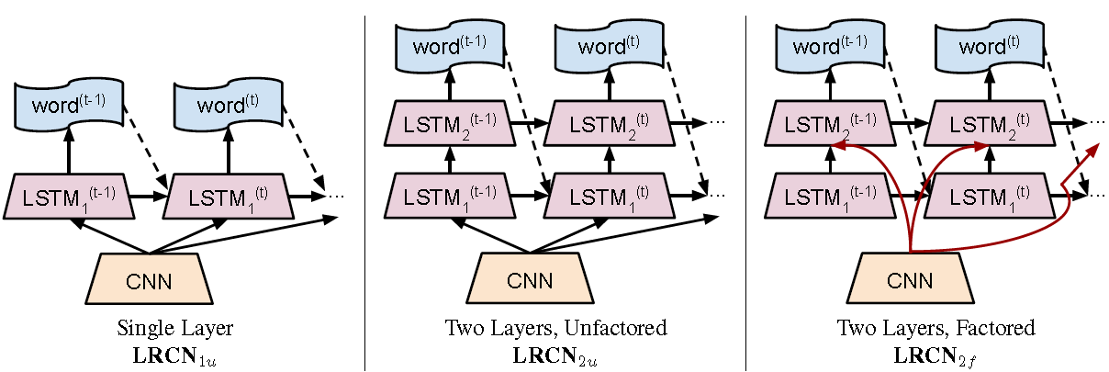
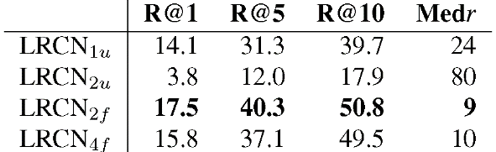
Image/video captioning
Train on 108,000 images with descriptions
Test on 1000 images (5 descr per image)
For each image score 5000 descriptions
See if top-k has a correct description:
[Donahue et al. 2015]

Slide 13
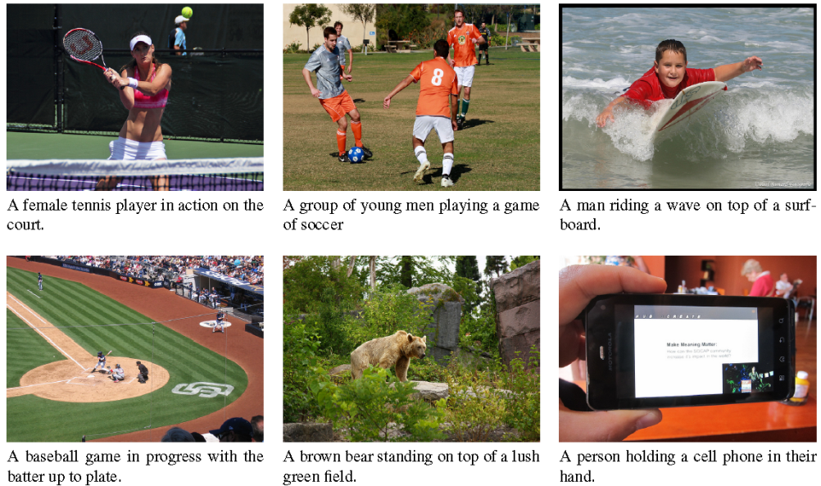
Image/video captioning
Best results:
[Donahue et al. 2015]

Slide 14
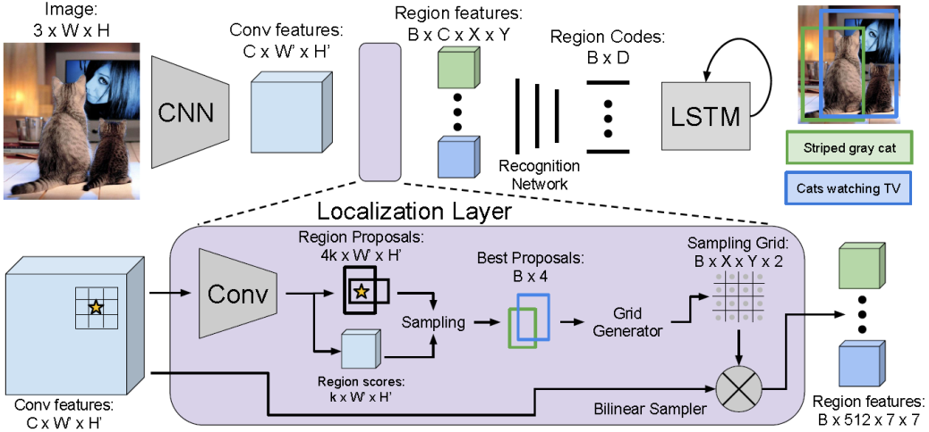
End-to-end dense image captioning
VGG-16 conv
fully-connected, 2 layers+dropout
k-anchors at W’xH’ positions
[Johnson et al, CVPR16]

Slide 15
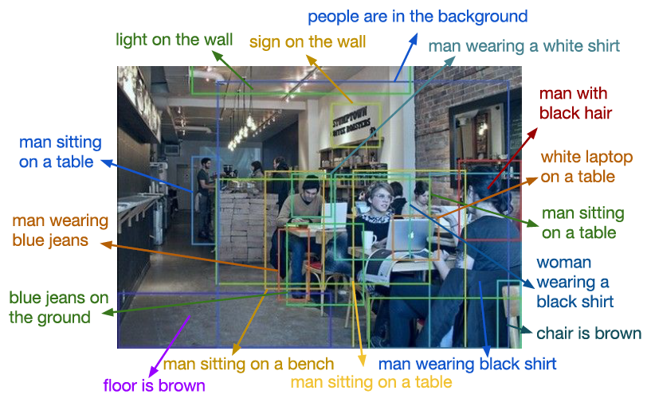
End-to-end dense image captioning
[Johnson et al, CVPR16]

Slide 16
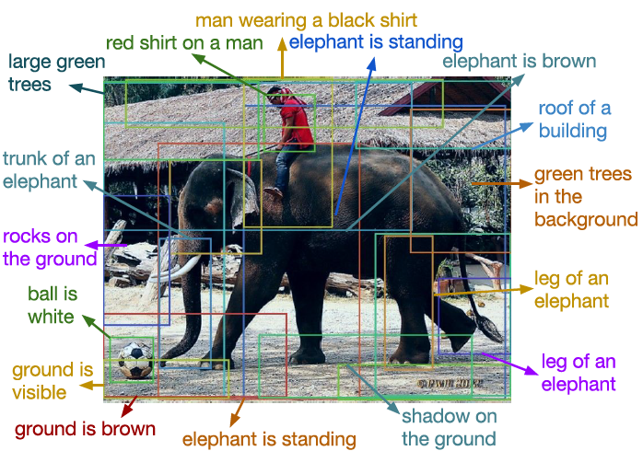
End-to-end dense image captioning
[Johnson et al, CVPR16]

Slide 17
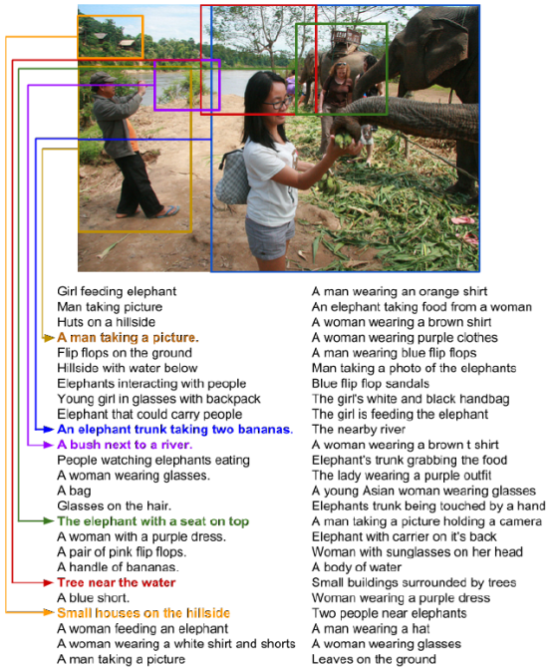
Training set: “visual genome”
“New Image-net”
108,249 Images
4.2 Million Region Descriptions
1.7 Million Visual Question Answers
2.1 Million Object Instances
1.8 Million Attributes
1.8 Million Relationships
Everything Mapped to Wordnet Synsets
[Krishna et al. 2016]

Slide 18
Sequence-to-sequence machine translation
[Sutskever et al. NIPS14]

Slide 19
Sequence-to-sequence machine translation
Important notes:
Fixed lexicon (160,000 English, 80,000 French) + ‘UNK’ word
Deep (four layers, 1000 cells in each)
Reversing input sequence helps a lot
Using two different LSTMs
Decoding proceeds by beam search
[Sutskever et al. NIPS14]

Slide 20

Sequence-to-sequence machine translation
Problem:
all the meaning has to be carried from here
Large memory needed
Information has to survive for a very long time
[Sutskever et al. NIPS14]

Slide 21
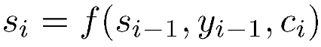
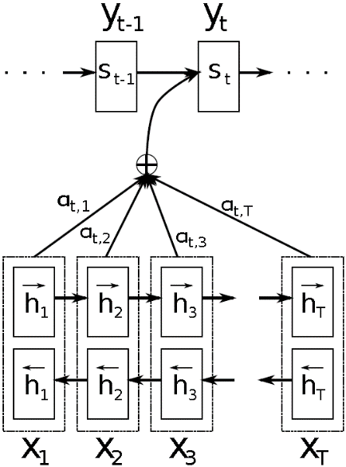
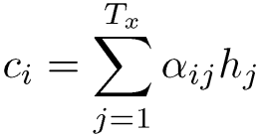
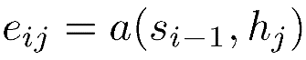
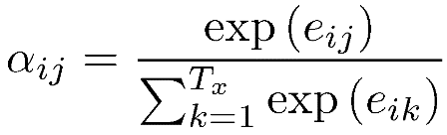
Translation with attention
decoder RNN
encoder RNN 1
encoder RNN 2
[Bahdanau et al. 2015]

Slide 22
Translation with attention
decoder RNN
Attention model:
feed-forward neural network
All components are trained end-to-end
encoder RNN 1
encoder RNN 2
[Bahdanau et al. 2015]

Slide 23
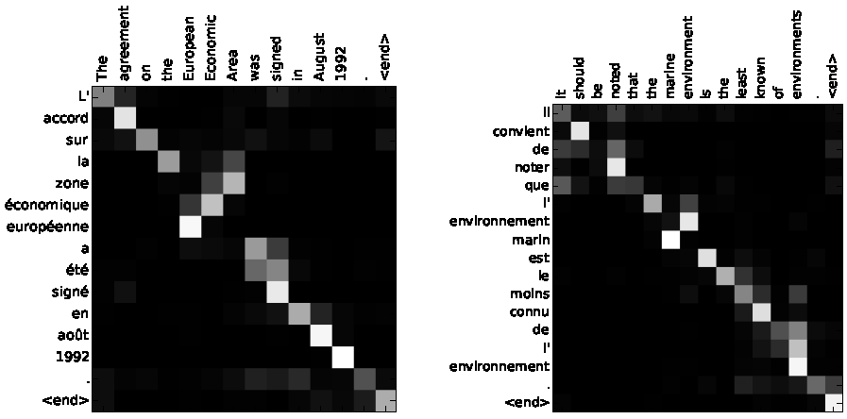
Translation with attention
[Bahdanau et al. 2015]

Slide 24
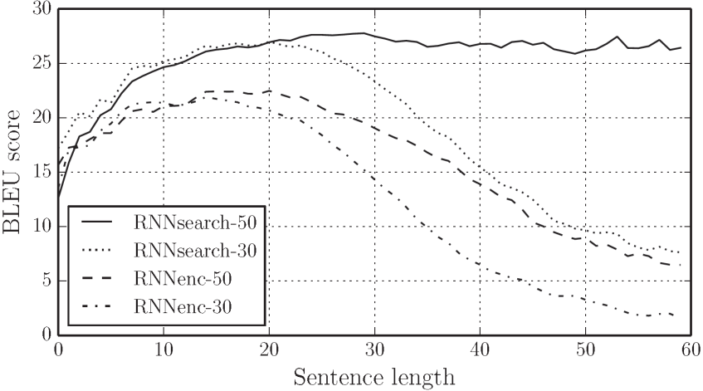
Translation with attention
BLEU-score ≈ precision over n-grams
Trained either with <30 word phrases or with <50 word phrases
[Bahdanau et al. 2015]

Slide 25
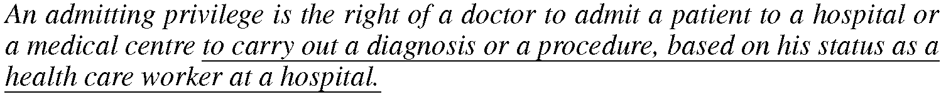
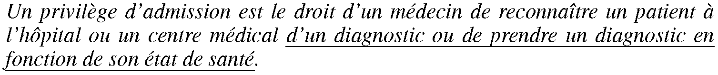
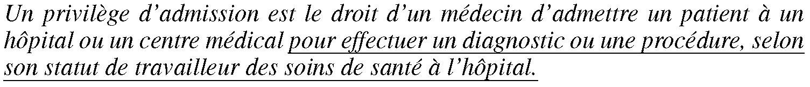
Translation with attention
LSTM system:
Attention-based system:
[Bahdanau et al. 2015]

Slide 26
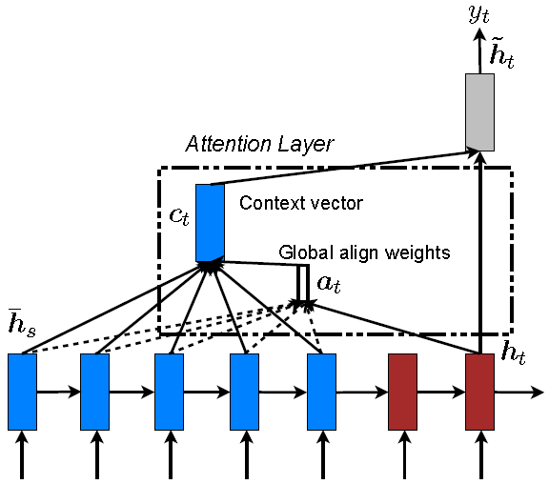
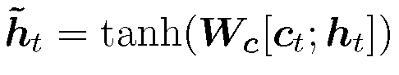
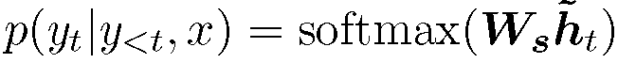
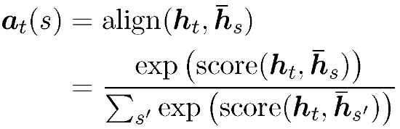
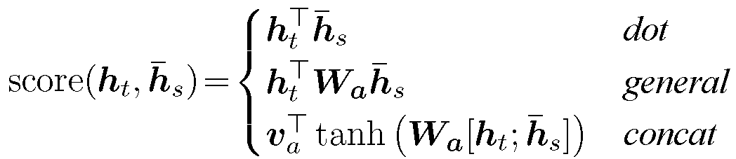
Simpler translation with attention
Quadratic complexity!
[Luong et al. 2015]

Slide 27
Recap
Attention solved the limited memory problem
Complexity is quadratic (in the length of sequence)

Slide 28
Online seq2seq with monotonic alignment
Many problems are sequence 2 sequence with monotonic alignment:
Not one-to-one as sequence prediction or POS tagging
More constrained than general seq2seq
[Graves et al. 2006]

Slide 29
Online seq2seq with monotonic alignment
Decoding: ‘aaa__bb_c____ddaa’ → abcda
What should be the loss that encourage correct parsing?
Answer: connectionist temporal classification (CTC) loss
[Graves et al. 2006]

Slide 30
CTC-loss
Augment the output state with blank
Predict probabilities of each symbol (inc. blank) at each time moment
Compute the probability of each lattice vertex under correct paths using forward-backward
Push log-probabilities up (ML training) proportionally to the current probability
[Graves et al. 2006]

Slide 31
Evolution of the CNC signal
GT sequence:
Prediction
Gradient w.r.t. prediction
[Graves et al. 2006]

Slide 32

LSTM demo: handwriting recognition
LSTM RNN Demo by Nikhil Buduma:
https://www.youtube.com/watch?v=mLxsbWAYIpw

Slide 33
Stack augmented RNNs
Inherent limitation of RNNs: memory capacity
Increasing memory by n gives the increase of parameters by n²
Conclusion: we need to decouple memory and operations (thnik RAM and CPU!)
[Joulin and Mikolov NIPS15]

Slide 34
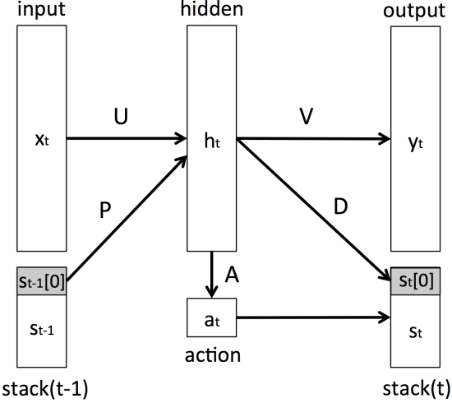
Stack augmented RNNs
Conclusion: we need to decouple memory and operations (think RAM and CPU!)
[Joulin and Mikolov NIPS15]

Slide 35

Stack augmented RNNs
[Joulin and Mikolov NIPS15]

Slide 36
Stack augmented RNNs
[Joulin and Mikolov NIPS15]

Slide 37
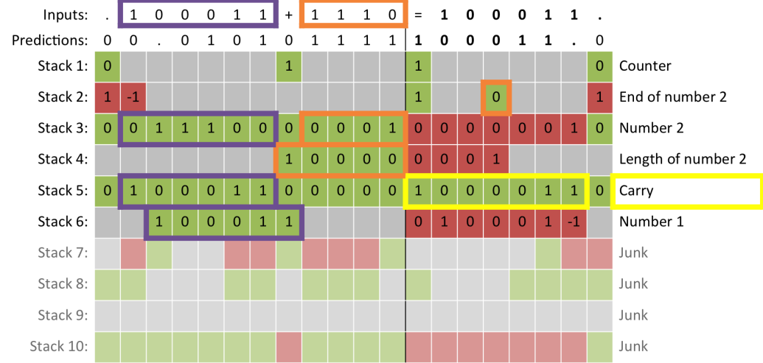
Binary addition with stack-RNN
Goal: train a network that can add binary numbers.
PUSH POP
NB: the answer is reversed, i.e. 101+11 = 0001

Slide 38
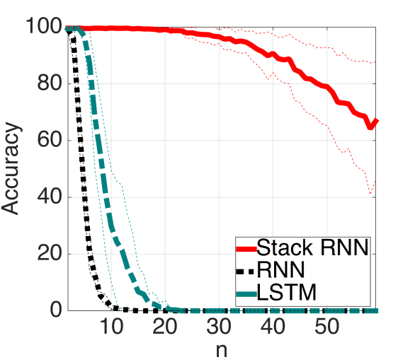
Binary addition with stack-RNN
Training with total lengths upto 20
100 hidden units and 10 1-dim stacks

Slide 39
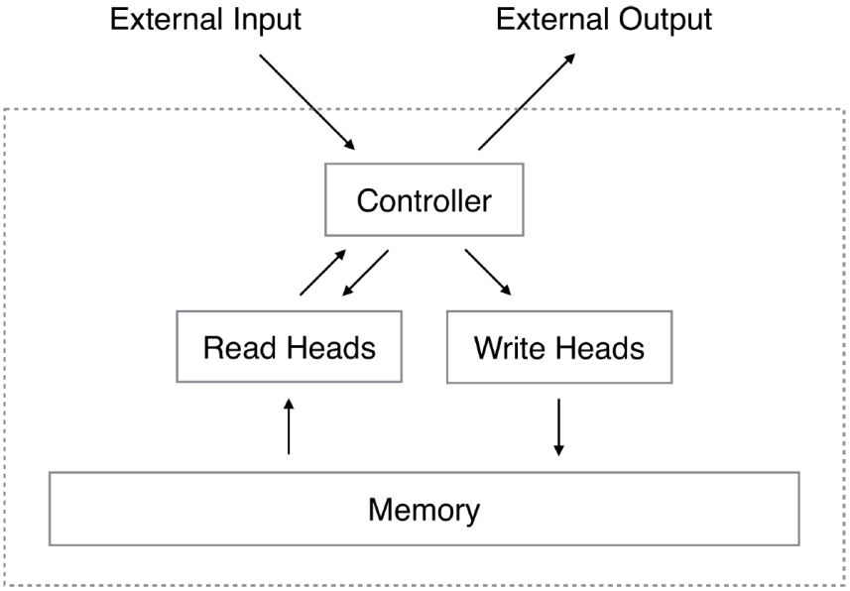
Neural Turing Machine
RNN, LSTM, CNN
[Graves et al. 2014]

Slide 40
Outlook
RNNs allow to solve many problems with sequences (as inputs or outputs)
CTC-loss is useful for monotonically aligned input-output tasks
The attention idea is working and is used across different domains (e.g. computer vision)
Learning a computer to “program” is ambitious and promising
Currently works only for simplistic algorithms
Differentiability requires real-valued (soft) values
Learning systems that make discrete choices is harder (but possible)

Slide 41
Bibliography
A. Graves. Supervised Sequence Labelling with Recurrent Neural Networks. Textbook, Studies in Computational Intelligence, Springer, 2012
Sepp Hochreiter, Jürgen Schmidhuber: Long Short-Term Memory. Neural Computation 9(8): 1735-1780 (1997)
Ilya Sutskever, Oriol Vinyals, Quoc V. Le:
Sequence to Sequence Learning with Neural Networks. NIPS 2014: 3104-3112
Jeff Donahue, Lisa Anne Hendricks, Sergio Guadarrama, Marcus Rohrbach, Subhashini Venugopalan, Trevor Darrell, Kate Saenko:
Long-term recurrent convolutional networks for visual recognition and description. CVPR 2015: 2625-2634
Justin Johnson, Andrej Karpathy, Li Fei-Fei, DenseCap: Fully Convolutional Localization Networks for Dense Captioning. CVPR 2016
Ranjay Krishna, Yuke Zhu, Oliver Groth, Justin Johnson, Kenji Hata, Joshua Kravitz, Stephanie Chen, Yannis Kalantidis, Li-Jia Li, David A. Shamma, Michael S. Bernstein, Fei-Fei Li: Visual Genome: Connecting Language and Vision Using Crowdsourced Dense Image Annotations. CoRR abs/1602.07332 (2016)
D. Bahdanau, K. Cho, and Y. Bengio: Neural machine translation by jointly learning to align and translate. In ICLR 2015.

Slide 42
Bibliography
Minh-Thang Luong, Hieu Pham, Christopher D. Manning:
Effective Approaches to Attention-based Neural Machine Translation. CoRR abs/1508.04025 (2015)
Alex Graves, Santiago Fernández, Faustino J. Gomez, Jürgen Schmidhuber:
Connectionist temporal classification: labelling unsegmented sequence data with recurrent neural networks. ICML 2006: 369-376
Armand Joulin, Tomas Mikolov:
Inferring Algorithmic Patterns with Stack-Augmented Recurrent Nets. NIPS 2015: 190-198
Alex Graves, Greg Wayne, Ivo Danihelka:
Neural Turing Machines. CoRR abs/1410.5401 (2014)

